Slide 2
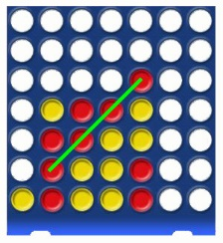
1.6 Connect Four
Objectives
The participants learn to construct a line by 2 points.
The students learn that 4 points can be the same line or not.
The participants determine the approach, materials and strategies to be used in this game
Tools, Materials and Organisation
Each of the two players needs a “Connect Four” board. If you don’t have enough boards, you can use instead of a board a sheet of paper as a simulation of the board (see below).
The lesson takes 45 minutes. The students can do the second part of the lesson only, if they have learned about coordinates in lesson 1.5

Slide 3
1.6 Connect Four
Description of the Lesson
First part of the lesson (25 minutes)
Make groups of two participants.
Always two players have
either an original board with chips in two colours or
two pencils in two colours and a game template (see below).
Play the game several times. Discuss about the strategies.
Second part of the lesson (20 minutes)
Hand out the worksheets to each person one.
Follow the instruction on the worksheet.
If there is enough time, you can talk about the differences between two and three dimension games.
Useful Hints
Here you see the simulation of the game, if you don’t have an original board.
Please be aware, that you fill the rows without a gap from the top in direction of the arrow!

Slide 4
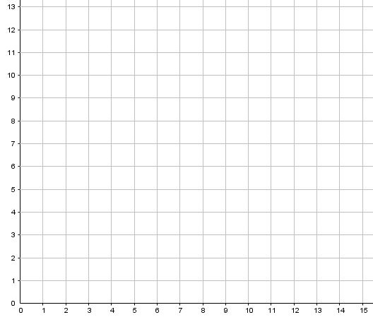
1.6 Connect Four
What is a distance line?
A distance line is a geometric element with the following characteristics:
The shortest connection of two points determines a distance line.
Construct in the grid on the left side two points with the coordinates P(3|2) and Q(9|8)!
Take a ruler and a pencil and connect these two points by a straight line.
The line is the shortest connection between two points.
As the line is bounded by the points P and Q one says “line segment”.

Slide 5
1.6 Connect Four
Plot more points in the painting on the left side:
R(5|4)
S(3|7)
T(7|6)
U(10|4)
What characteristics do these points have?
Points R and T are on the line segment, points S and U not.
You win the game “Connect Four”, if you can put 4 of your own chips = 4 points in a line!

Slide 6
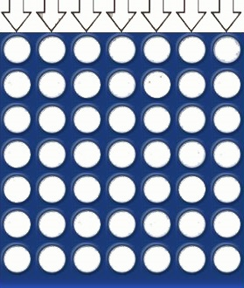
1.6 Connect Four
1
2
3
4
5
6
7

